Slide 1




Using big data to help feed the world
Todd Pugh – Director of Technology, Enterprise Solutions, US

Slide 2






Who is Proagrica?
A global provider of information and analytics for professional and business customers across industries
Deep customer understanding
Leading content & datasets
Sophisticated analytics
Technology capabilities
RISK AND BUSINESS ANALYTICS
Proagrica provides web, mobile, digital, data management & business intelligence solutions across the global Agriculture and Animal Health markets.
Integration & connectivity
Insight & analytics
Visualization & workflow
Proagrica’s integration technology connects systems and workflows, both internally and externally, enhancing the harmony and efficiency of business transactions.
Proagrica provides a platform that allows you to derive previously un-seen value from data. Empowering informed decisions with improved visibility and reporting in real-time.
Proagrica provide solutions to enhance productivity across all agriculture sectors. We give manufacturers, distributors and farmers the tools they need to efficiently do business.
Notes:
Resources and skills Proagrica as a whole – the competencies we have, and the competencies RELX bring, proving our experience in integration, analytics and workflows
A COMPETANCY is a harmonized combination of multiple resources and skills that distinguish a firm in the marketplace and therefore are the foundation of companies' competitiveness.

Slide 3
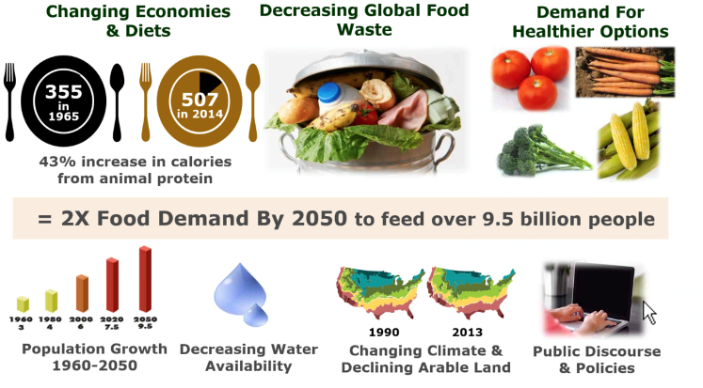

Agriculture is at the centre of global change

Slide 4
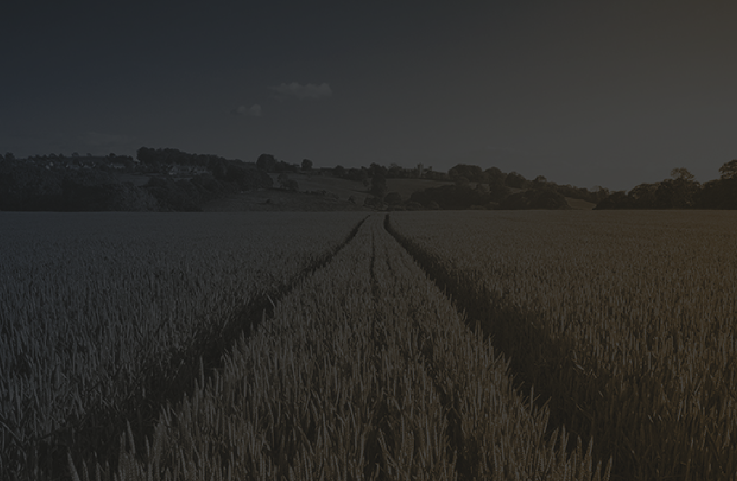
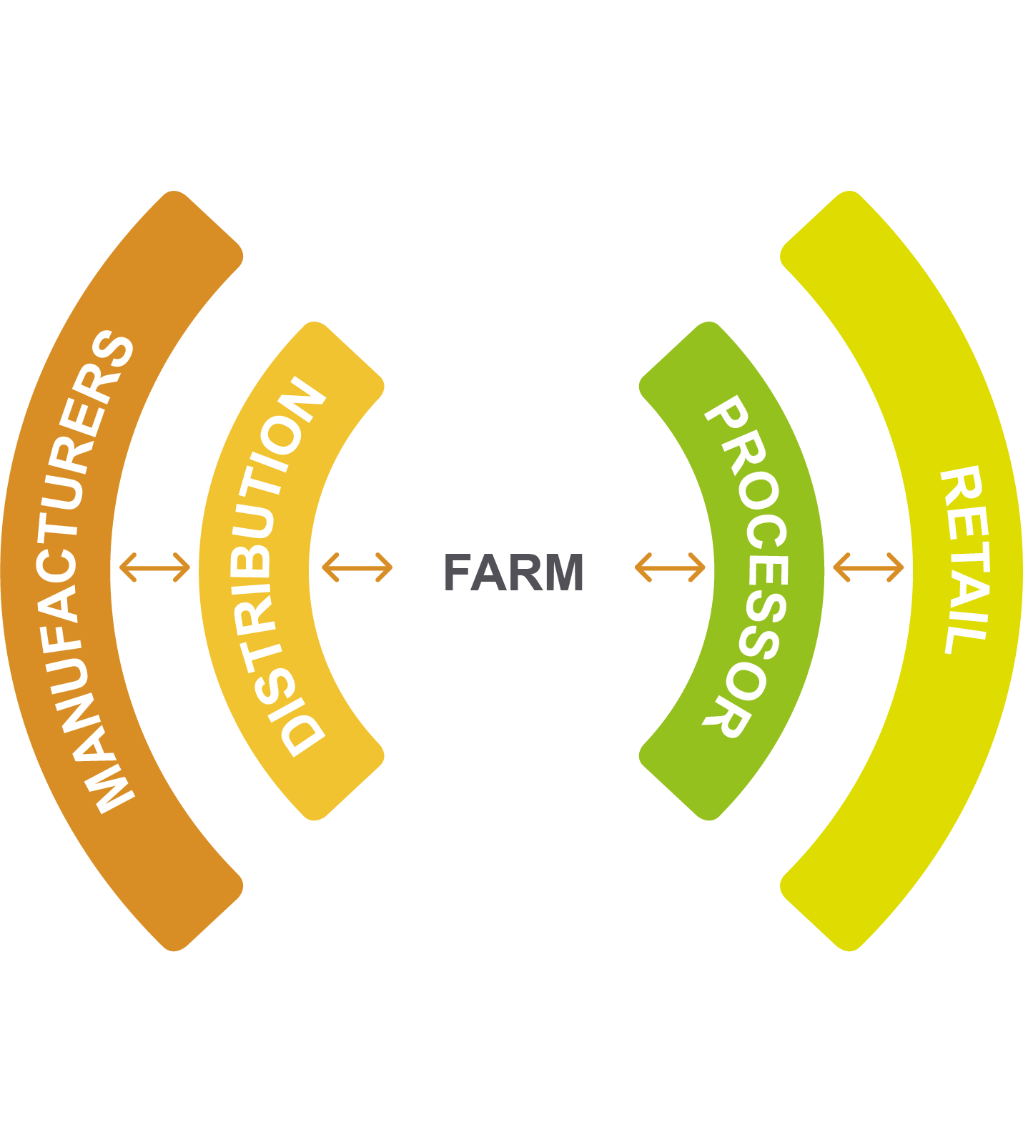
Analytics
solutions
Data
and insight
to support improved visibility
Allows
users to track data as it
moves

Slide 5
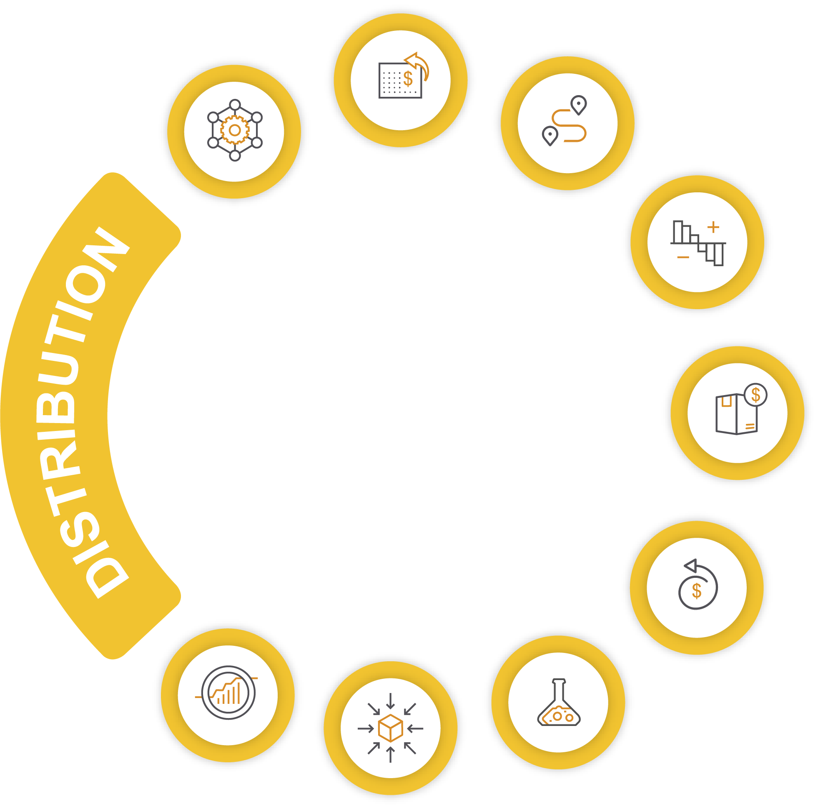

Empowering global agriculture through integration & data analytics, workflow tools and actionable intelligence to enhance trading, productivity and compliance

Slide 6
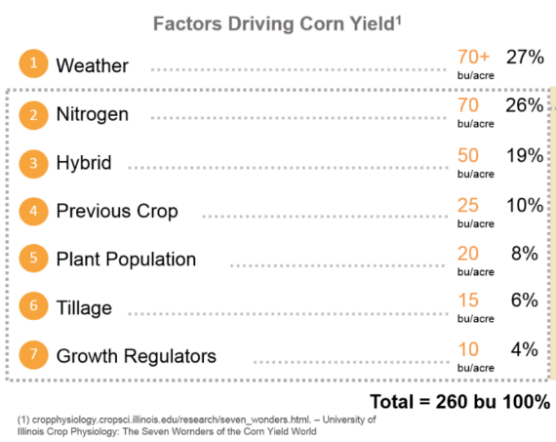
How could data help?

Slide 7









Our data landscape and assets
Vast amounts of data spread across the agriculture landscape. Proagrica is consolidating, organizing and enhancing this data to help drive value across the entire industry, from the farm all the way to the grocery store shelf.
Farm Management Information Systems (FMIS)
A wide spectrum of tools used by farmers all generating data
Farm Machinery
Every piece of equipment on the farm is now generating data and wants to be precise
Satellites / Drones
Ability to identify yield and crop issues from space / drones
Weather Data
Global current and historical weather and soil moisture data at sub-field level
Sensors
Ground and animal sensors measuring everything from animal fertility to soil moisture
Manufacturers & Distributors
Our B2B network manages supply chain connectivity between
Soil
Global soil type horizons
Agronomist
Providing farm advice, shape files and data to farmers

Slide 8
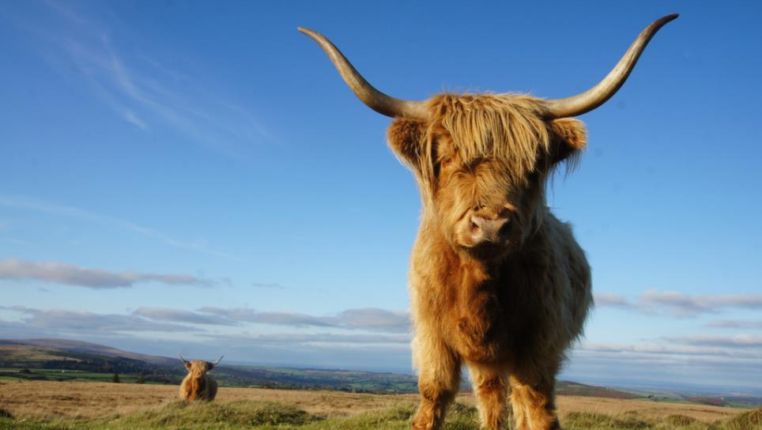
570 million farms, 25 million tractors, 50 billion chickens, 1 billion sheep, 1 billion pigs, 80 million turkeys, 1.5 billion cows in the world !
100% of them with passports in the UK vs 39% of the US population….
…and Big Data is here, for animals at least as they are all being monitored / reporting data

Slide 9
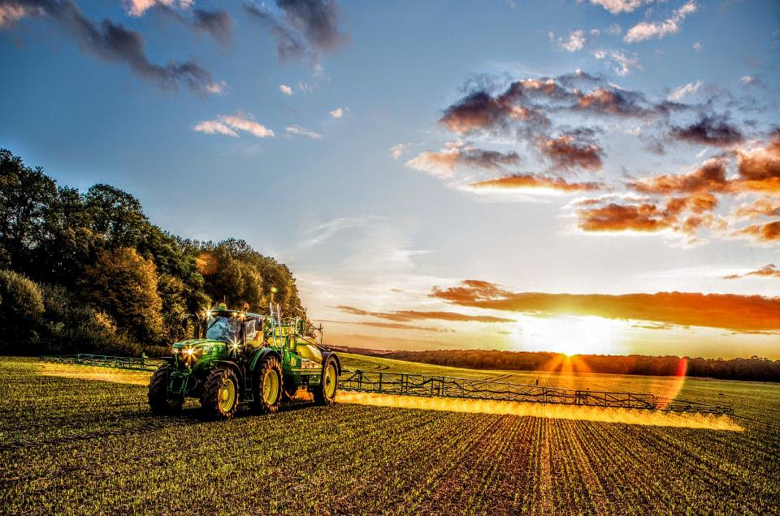



Source: aea.co.uk

Slide 10

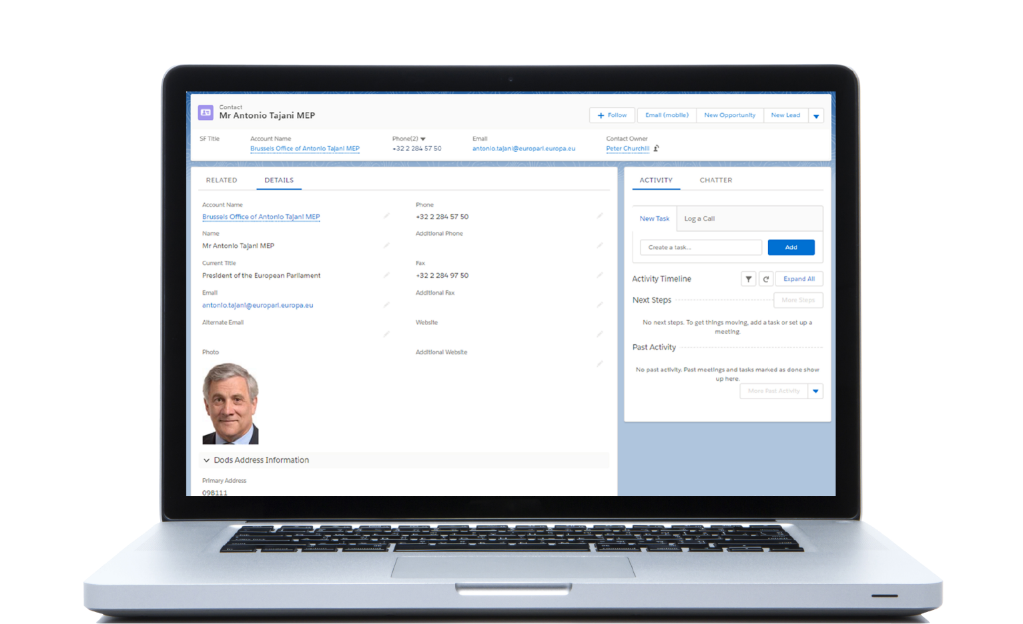
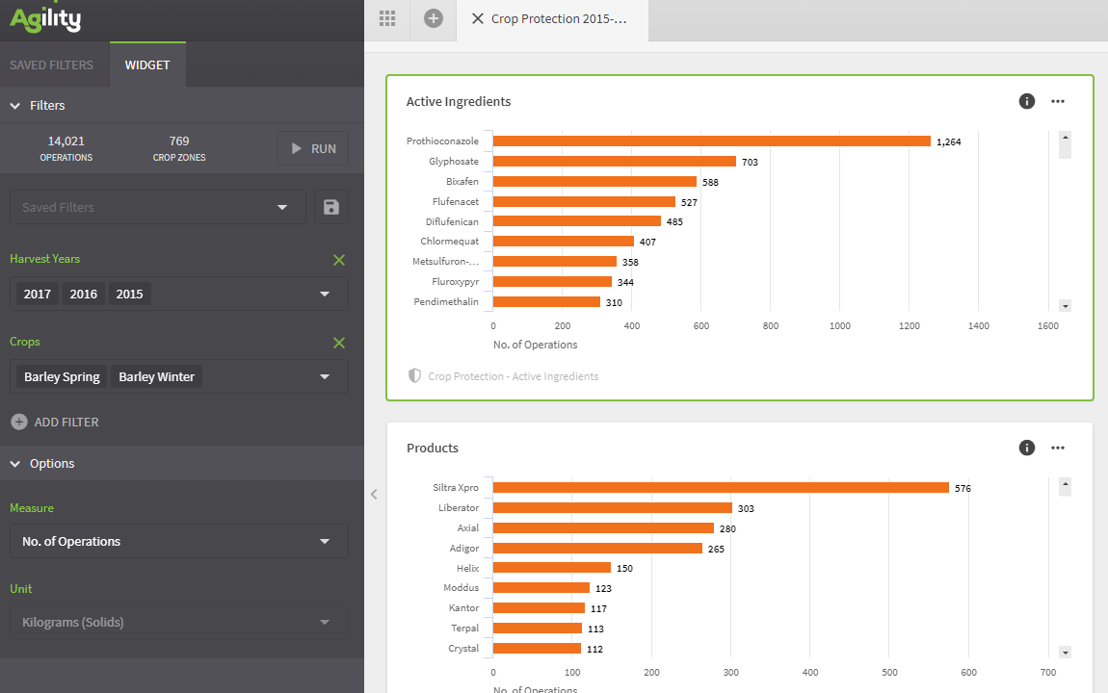
Data analytics platform
Real-time insights into the agri-food supply chain from multiple trusted data sources, enabling our customers to react quickly and forecast effectively, driving greater efficiency and maximizing profits.

Slide 11

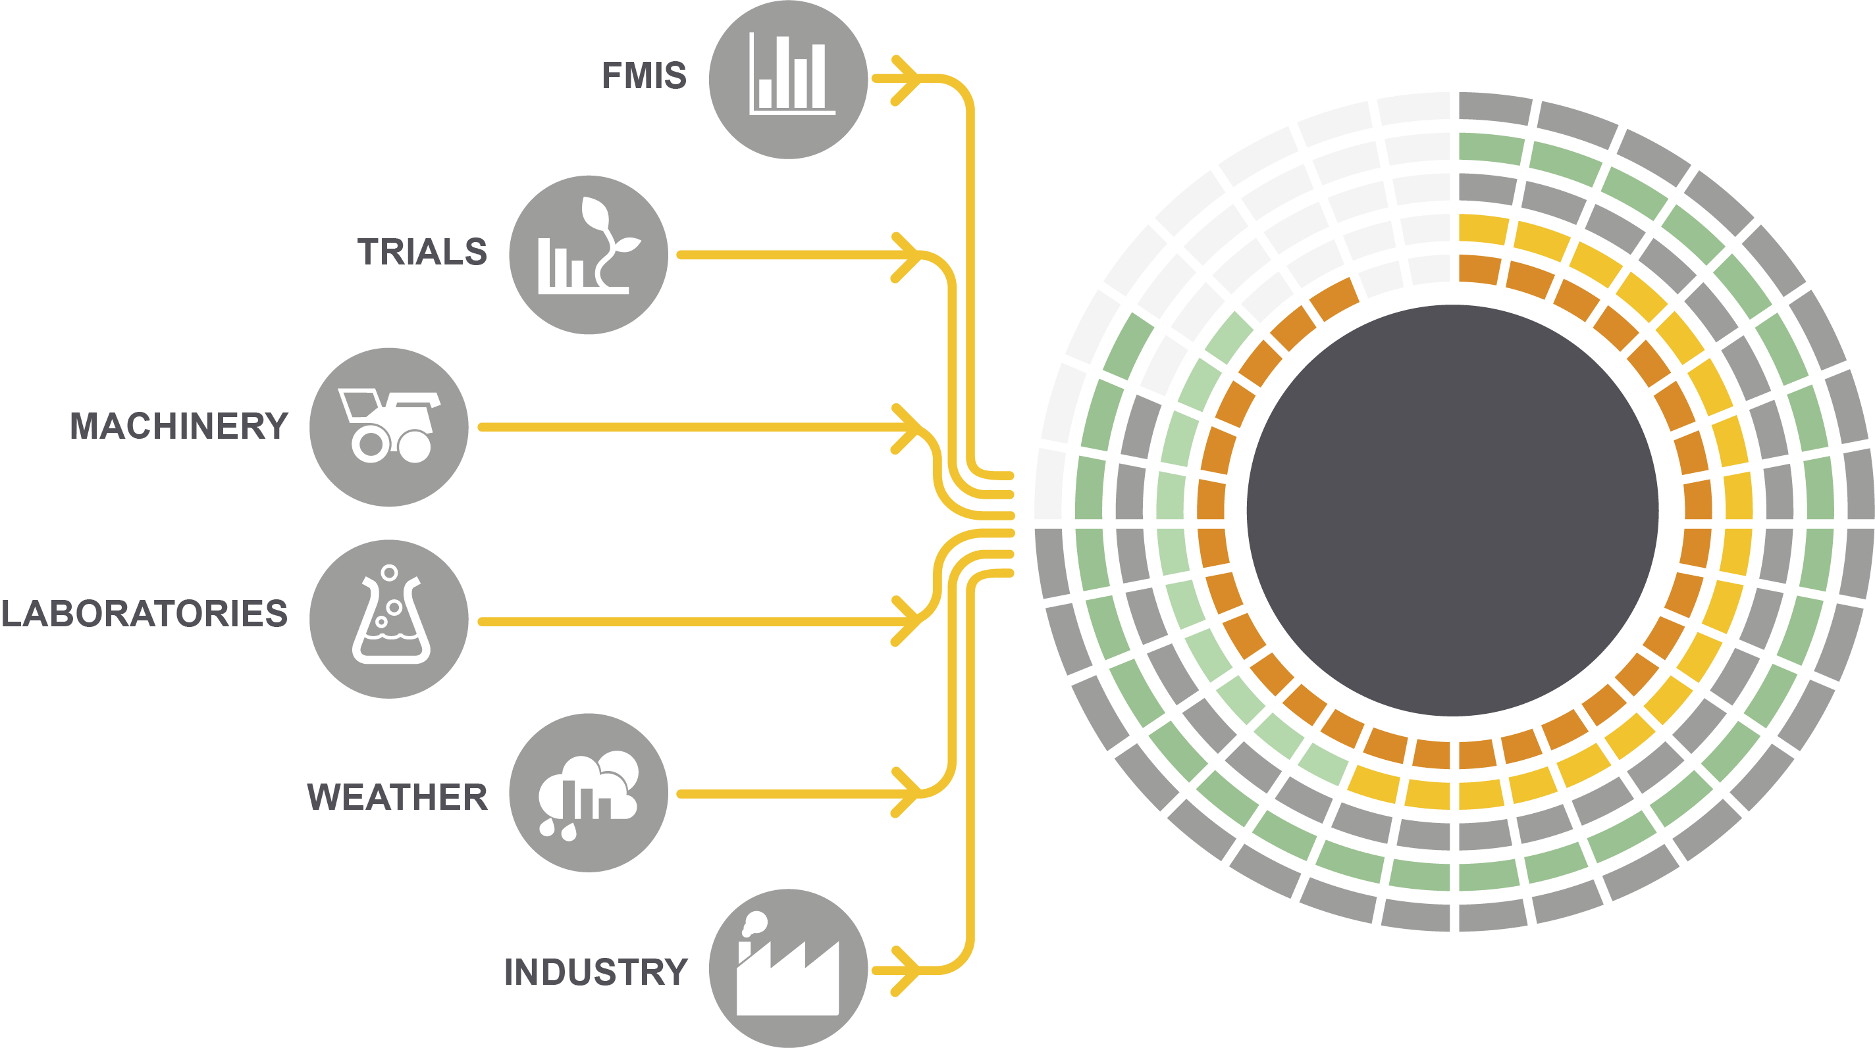

Data analytics platform
Collect
Standardize
Cleanse
Enrich
Analyze
Action

Slide 12
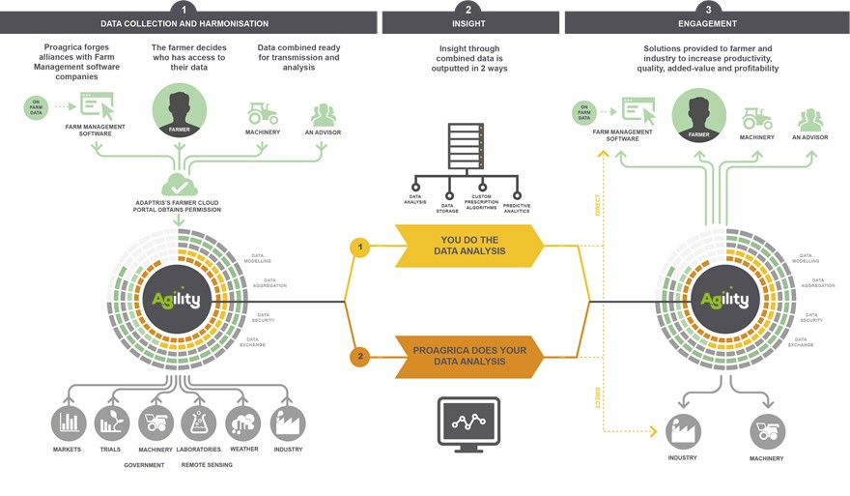
Data analytics platform

Slide 13





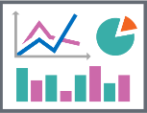




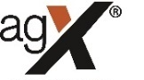














The Agility data platform
Data Sources
Data Integration
Data Processing
Delivery
CORE
Integration Framework facilitating data communications and messaging between systems.
Delivery of data and insights can happen through three distinct channels – each supported by its own primary tech stack
The Farm Management Systems we already connect to – or working on connecting.
STANDARDIZE
CLEANSE
ENRICH
STANDARDISATION
CLEAN UP
DATA VIZ
API
REPORTS
Mapping the source data schemas to the common Agility Domain Model.
Starts from the cleaning up of blatantly “bad” data and extends to the mapping of Products to Canonical Entities.
DATA VIZ
SUPPORTING
Other data sources we consume for enrichment or hygiene purposes.
ENRICHMENT
API (DATA FEEDS)
Referring to the enrichment of the dataset with the introduction of value-add datasets such as Chemistry (Actives), Environmental Conditions, Geopolitical Entities etc.

Slide 14
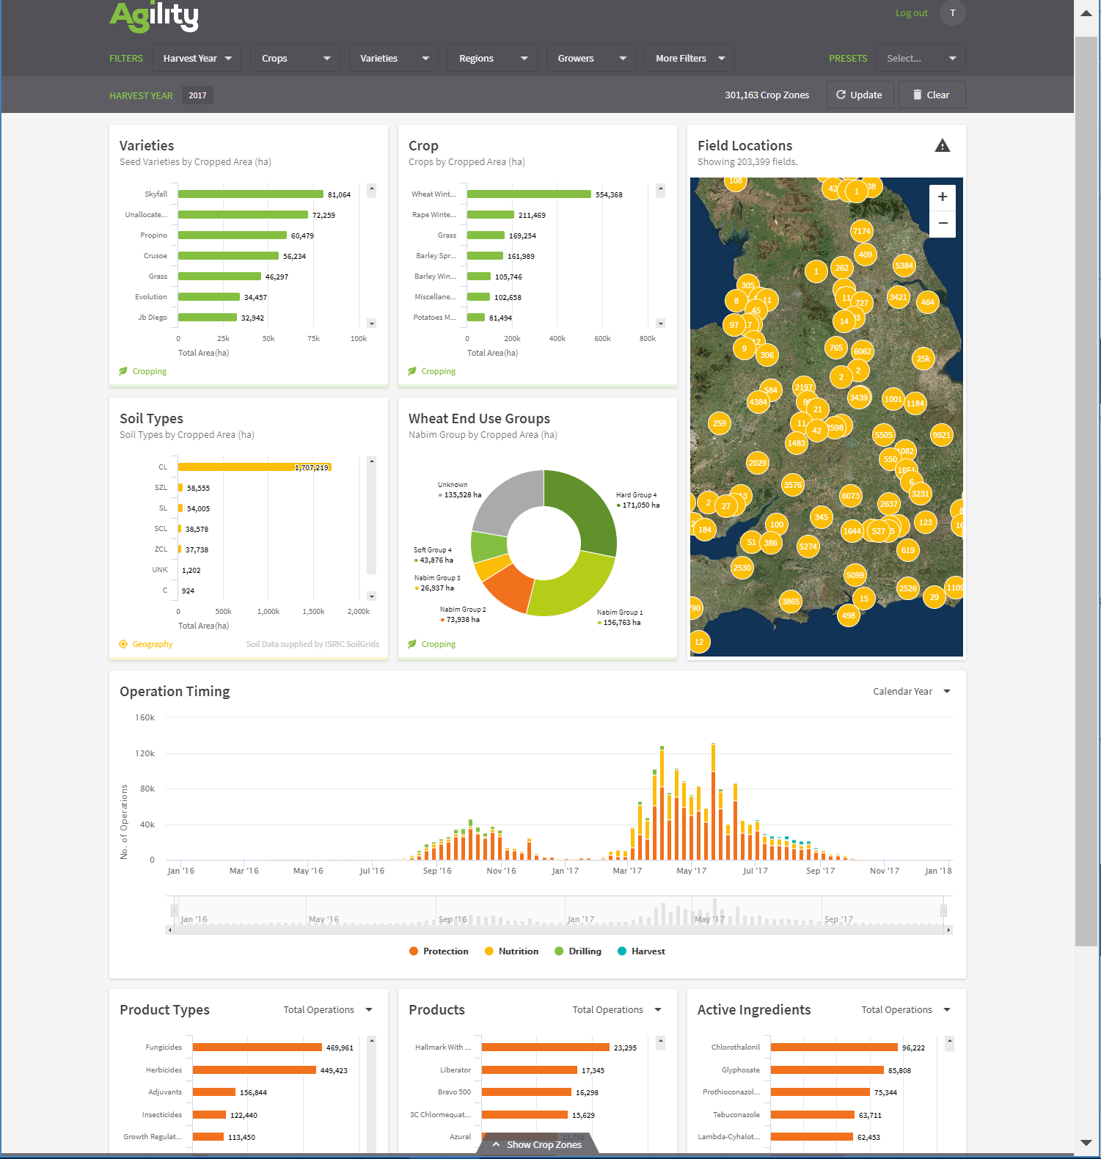
What does it deliver?
Global insight through fully integrated data, Data As A Service and a range of analytics tools
An agile, scalable, resilient and secure platform that can consume data from any source, consolidate, enrich and expose global agricultural data from everything soil to animals and all the way to satellites
Precision Ag covering the full Ag value chain from Mfr, through Agronomist, CO-OP, Farmer and Distributor
A range of Analytics solutions focused on Pesticides, Herbicides, Fertilizers, Seeds, Cattle, Milk, etc. that provide insight at market, region, farm, field and sub-field levels
Enabling the industry to increase yield and profitability whilst reducing inputs and improving environmental impact

Slide 15
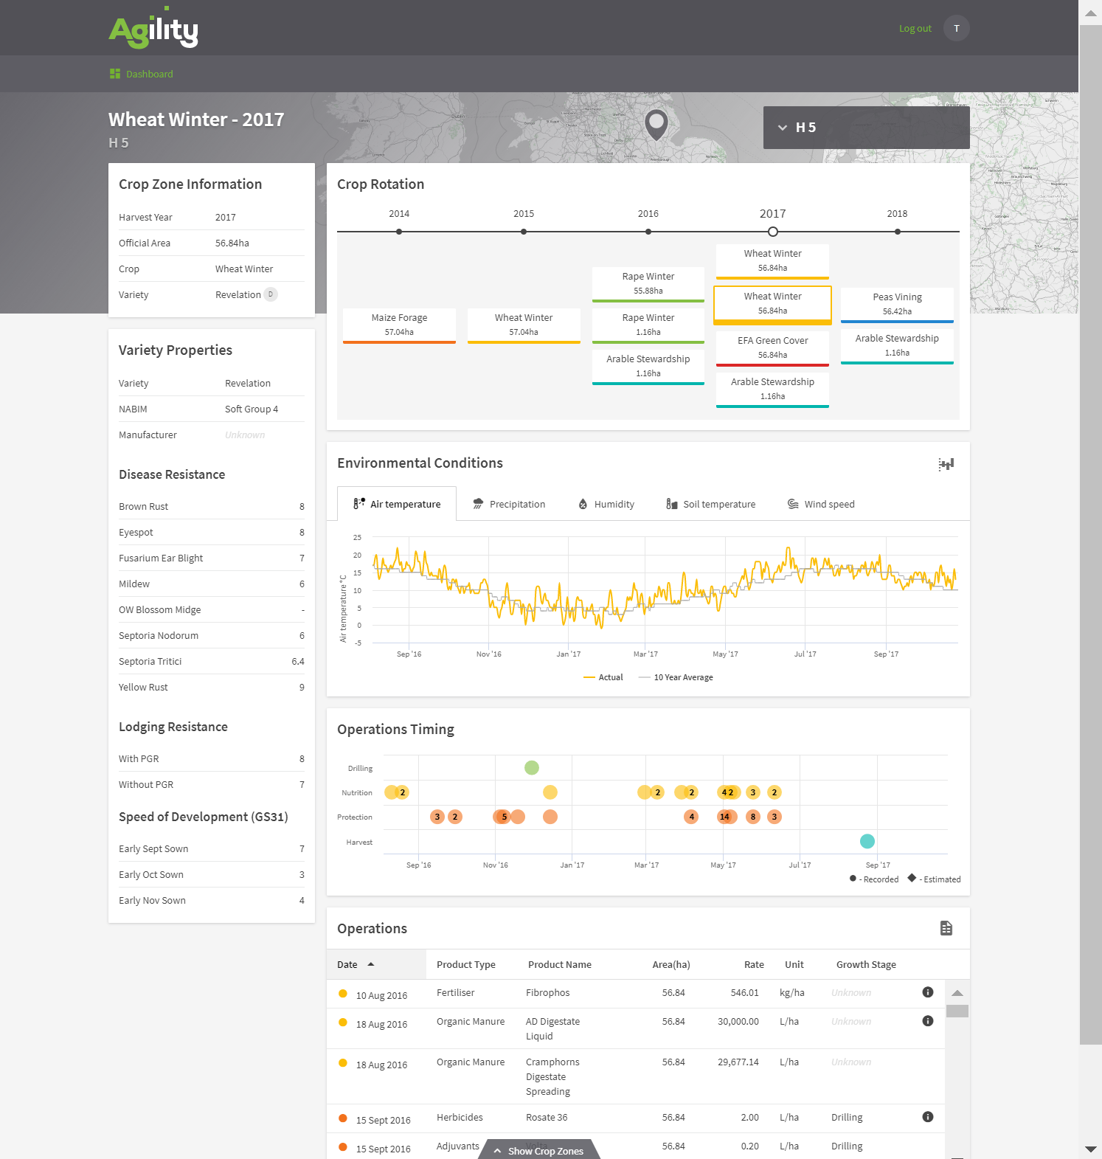
There’s a lot of detail

Slide 16
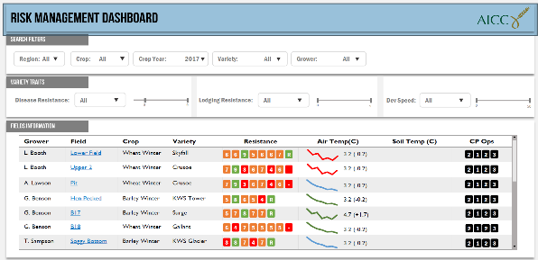
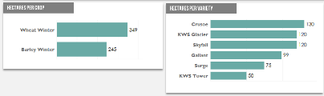
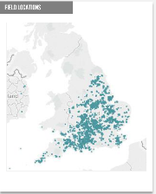
We can present it differently to manage risk

Slide 17
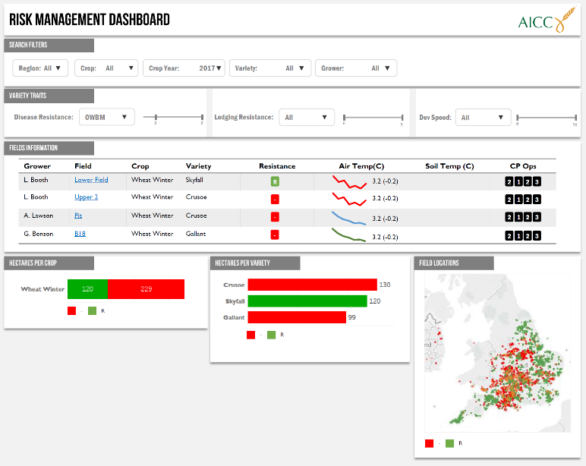
We can present it differently to manage risk

Slide 18
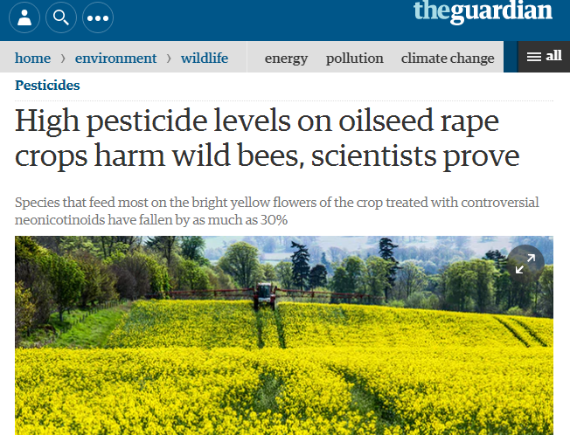
A worked example – Canola (OSR)
It is an edible crop
Food oil
High protein animal feed
BioDiesel
Lubricant
Variable yield
New diseases
Pesticide limitation
Tight profit margins

Slide 19
Patterns of canola using principal component analysis
Why was the 2016 harvest in the UK so awful?
What correlates to higher yields?
Are pesticides effective?
Are hybrids better?

Slide 20
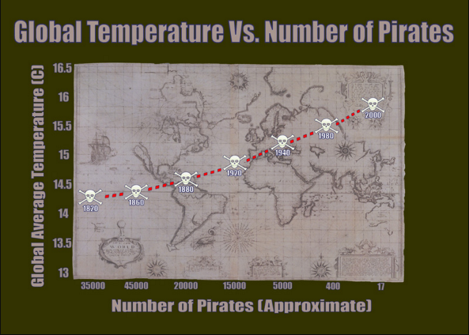
How has yield varied over the last 10 years?

Slide 21
Growers aren’t very skilled at data entry
CORE
CORE
DK Excaliber
DK Excalibur
Excalibur + Coating
Excalibur Stock
Excalibur and Catana
Rolled
OSR + 15:10:28
Excalibur
Excalibur
Excalibur
Excalibur
Other
Other
Other

Slide 22
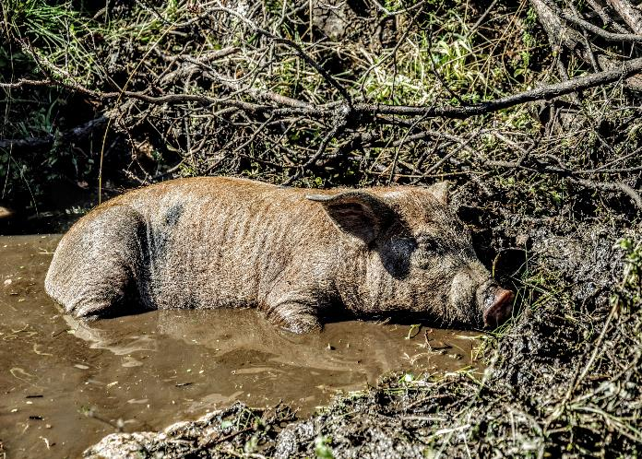
In case I forgot to mention
THE DATA IS DIRTY…..

Slide 23

It can also be incomplete

Slide 24
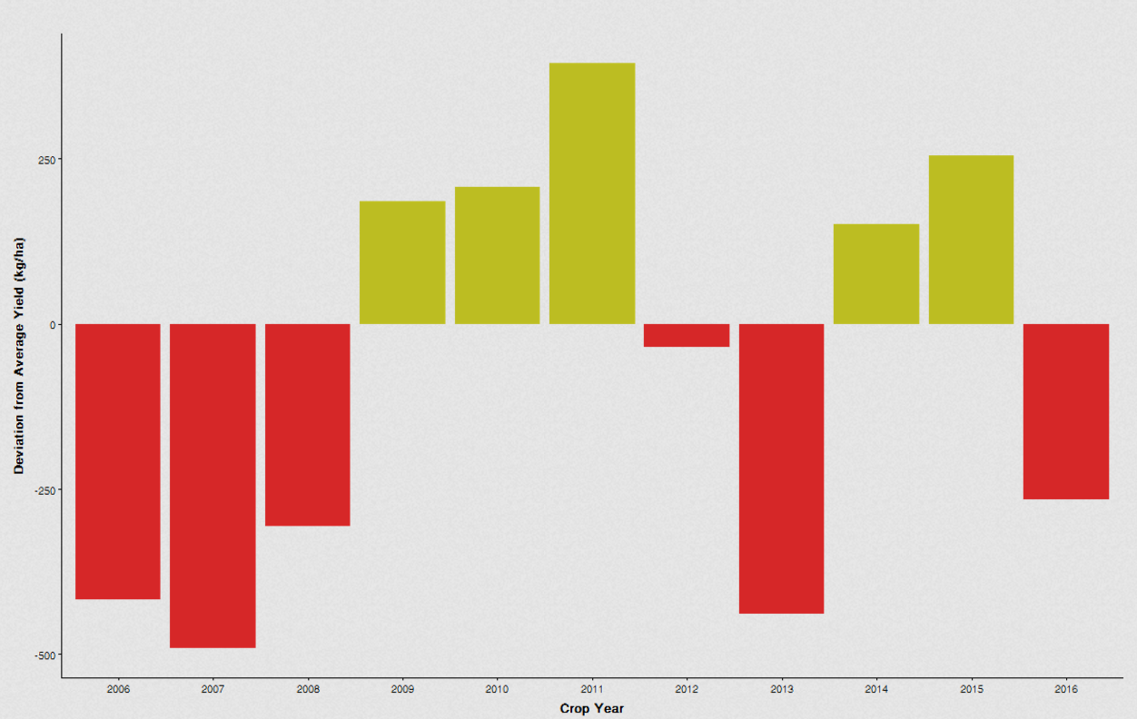
Correlation doesn’t equal causation
Average yield is 3,766 kg/ha

Slide 25
The spread in yield
Most growers are within 1,496 kg/ha of the average
5,250 kg/ha
3,750 kg/ha
2,250 kg/ha

Slide 26
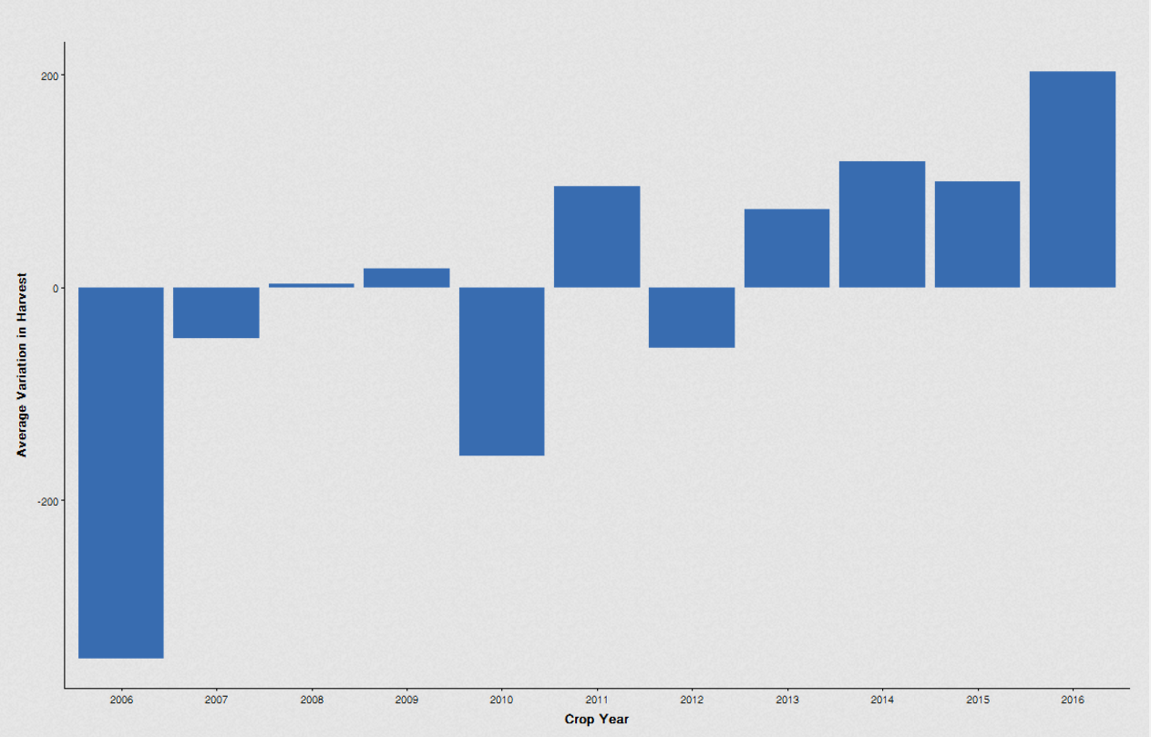
But this isn’t constant

Slide 27
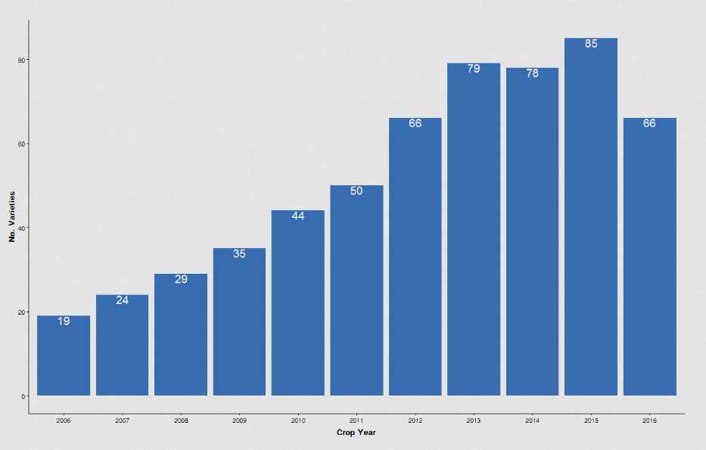
Could it be related to variety choice?

Slide 28
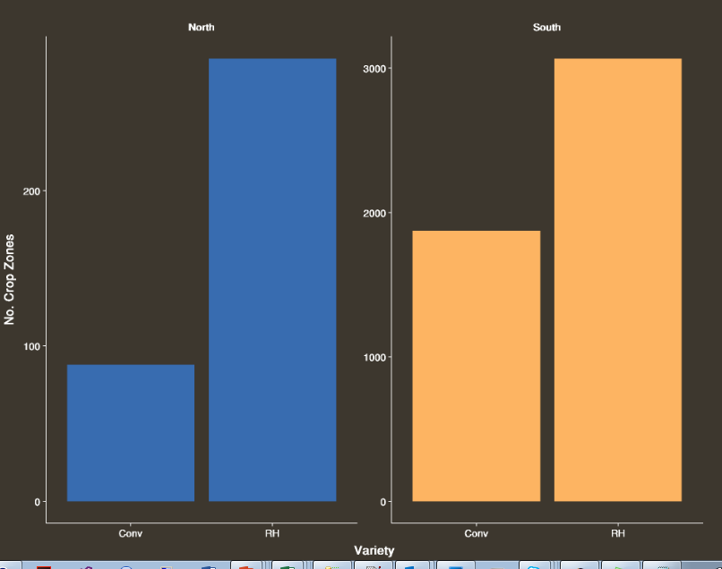
Popularity of hybrid varieties by location

Slide 29
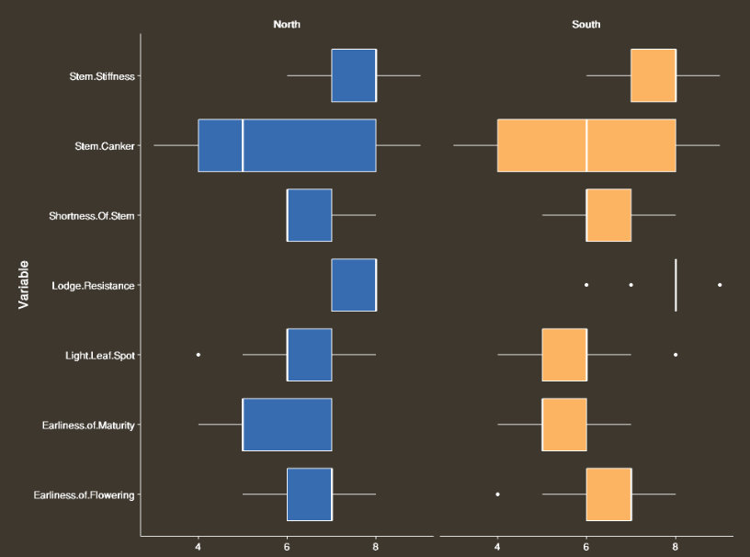
Variety trait differences by location

Slide 30

How do we visualize the data?
Over 150 pairs of variables to investigate
No idea what is linked before we start

Slide 31
What’s this 2D picture of a 3D object?

Slide 32
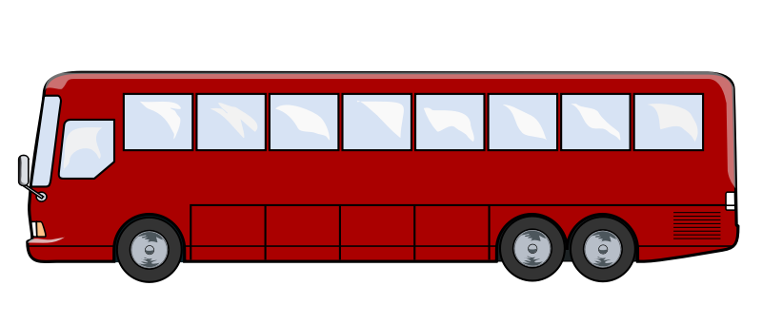
How about now?

Slide 33
How to read the graphs
Temperature
Yield
Two variables that are high at the same time

Slide 34
How to read the graphs
Yield
Two variables that are high at opposite times
Temperature

Slide 35
How to read the graphs
Temperature
Yield
Two variables that have nothing to do with each other

Slide 36
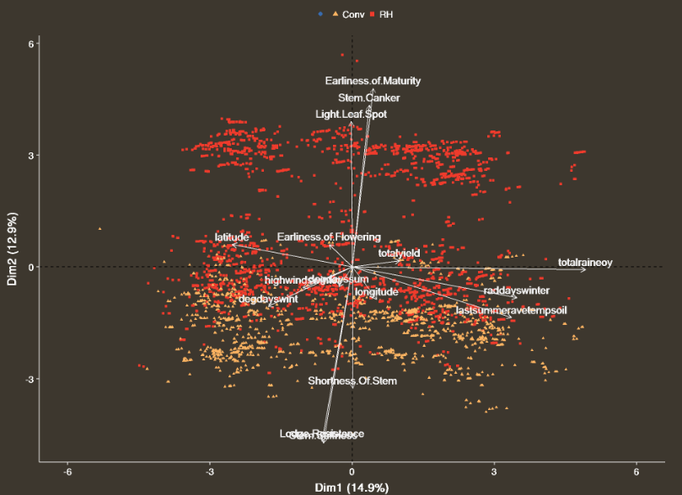
The market for OSR varieties

Slide 37
What causes variation in yield – it’s a similar story
Degree days
Fertilizer treatments
Fungicide treatments
Insecticide treatments
Month of first insecticide application
High wind events
Temperatures
Average rainfall
Coldest week
Total radiation
Wettest weeks
Driest weeks
Soil moisture
Precipitation
Latitude & longitude
Soil content

Slide 38
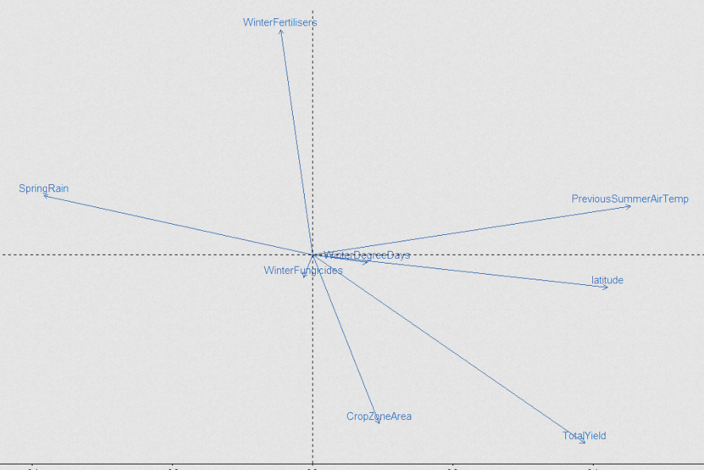
Overall, what correlates with a high yield?
Fertilizers not needed?
2016
Warm
summers
Dry springs
Warm winters
Larger and
Northern?
2015

Slide 39
At last,
some answers
Degree days
Fertilizer treatments
Fungicide treatments
Insecticide treatments
Month of first insecticide application
High wind events
Temperatures
Average rainfall
Coldest week
Total radiation
Wettest weeks
Driest weeks
Soil moisture
Precipitation
Latitude & longitude
Soil content

Slide 40
At last,
some answers
Why was the 2016 harvest in the UK so awful?
Wet spring and/or dry winter
What correlates to higher yields?
Warm spring, wet winters and proper pesticide application
Are pesticides effective?
Yes for fungicide, “perhaps” for insecticide
Are hybrids better?
Not really

Slide 41

Messages to take home
If you’re a farmer
There are probably too many varieties of Canola in the world!
Canola does better in wet springs and warm winters
If you’re into analytics
Working with big data is a lot of fun
Dimension reduction is great for picking out correlations in complex data

Slide 42

The independent experts in insight, workflows and data integration to the global agri-food industry
Making you more
informed, efficient & connected

