Slide 1
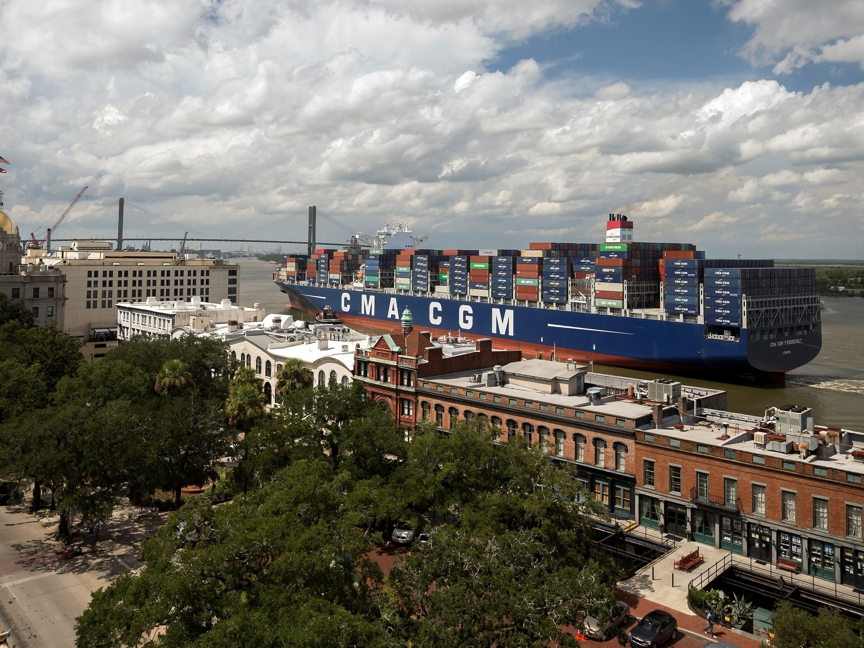

PORT OF SAVANNAH
Garden City Terminal: The Southeast Gateway for the U.S.
July 2018

Slide 2
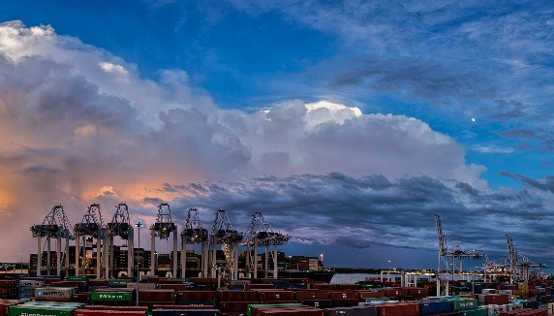
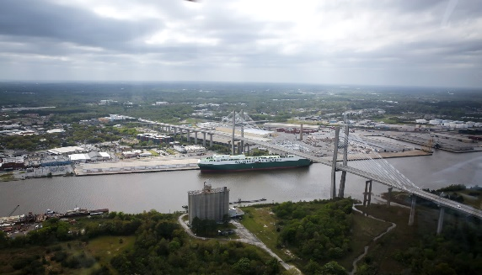
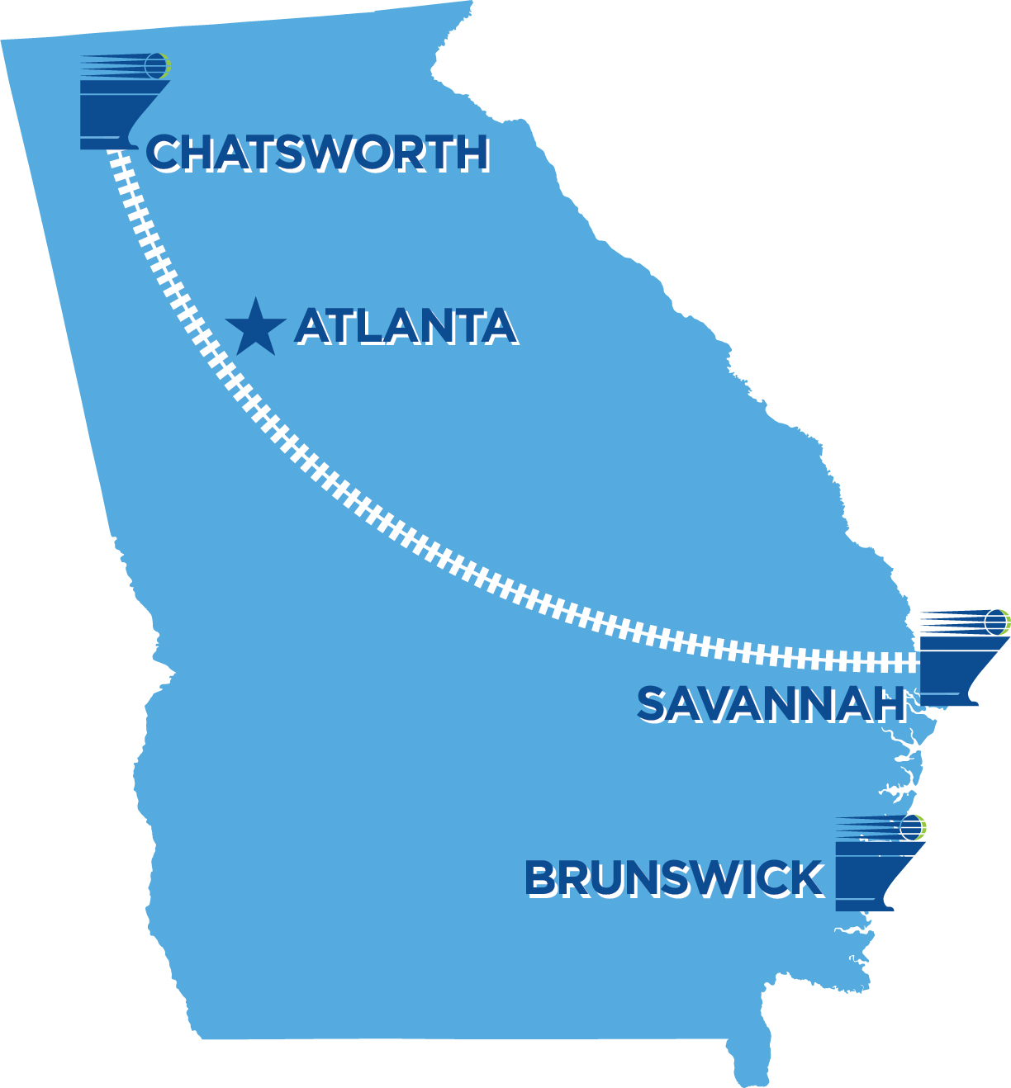
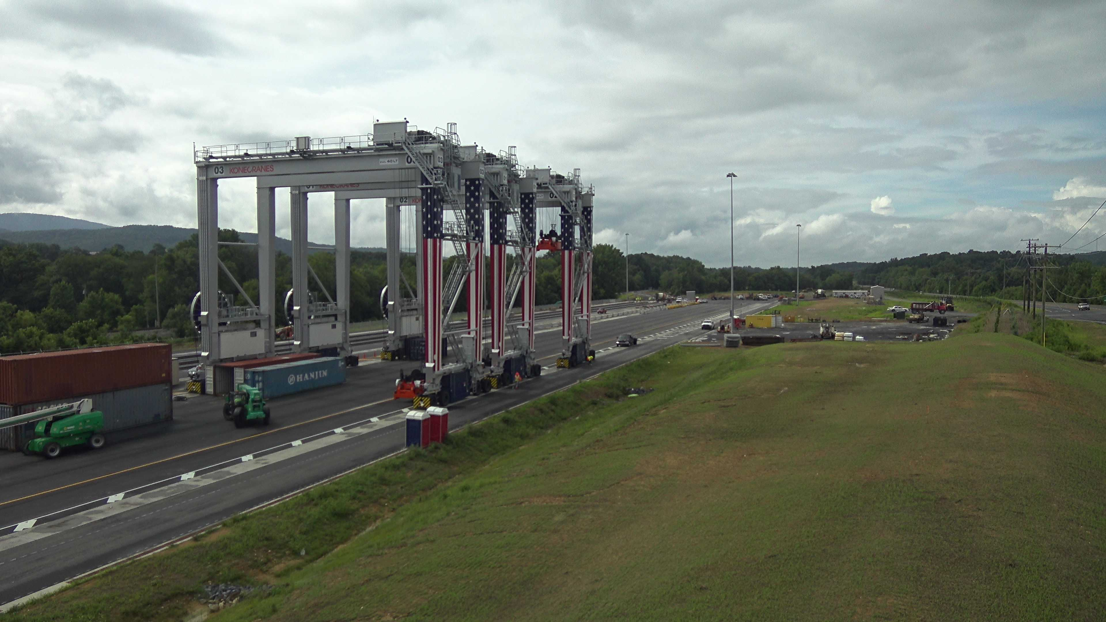
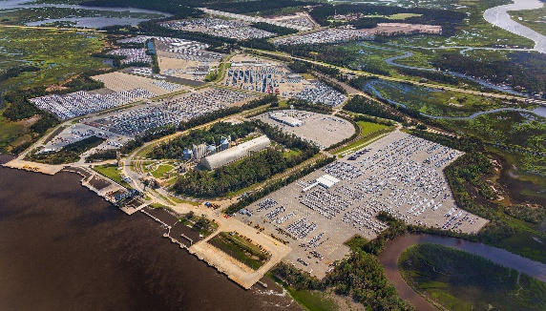
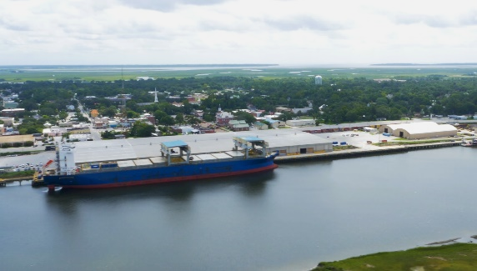
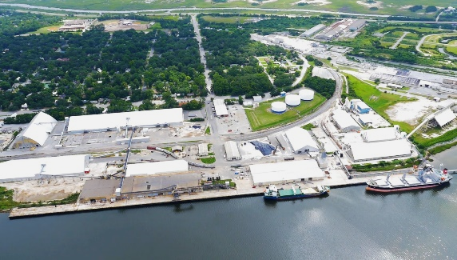
GEORGIA PORTS AUTHORITY
DEEPWATER & INLAND TERMINAL OPTIONS
Garden City Terminal
Ocean Terminal
Appalachian Regional Port
Colonel’s Island Terminal
Mayor’s Point Terminal
East River Terminal/Lanier Docks

Slide 3
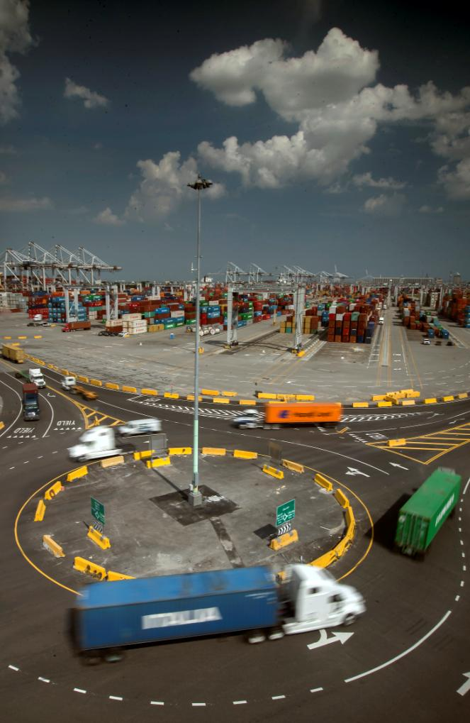
GPA: AN ECONOMIC ENGINE
STATE OF GEORGIA:
+439,000 full- and part-time jobs
$106 billion in sales (11% of total sales)
$44 billion in state GDP (8% of total GDP)
$25 billion in income (6% of total personal income)
NATIONWIDE:
$4.5 billion in federal taxes
8.5% of U.S. containerized trade**
10% of U.S. containerized exports**
19% of U.S. East Coast containerized trade**
Source: *Terry College of Business, University of Georgia (FY2017)
**U.S. Census Bureau– based on tonnage (CY2017)

Slide 4
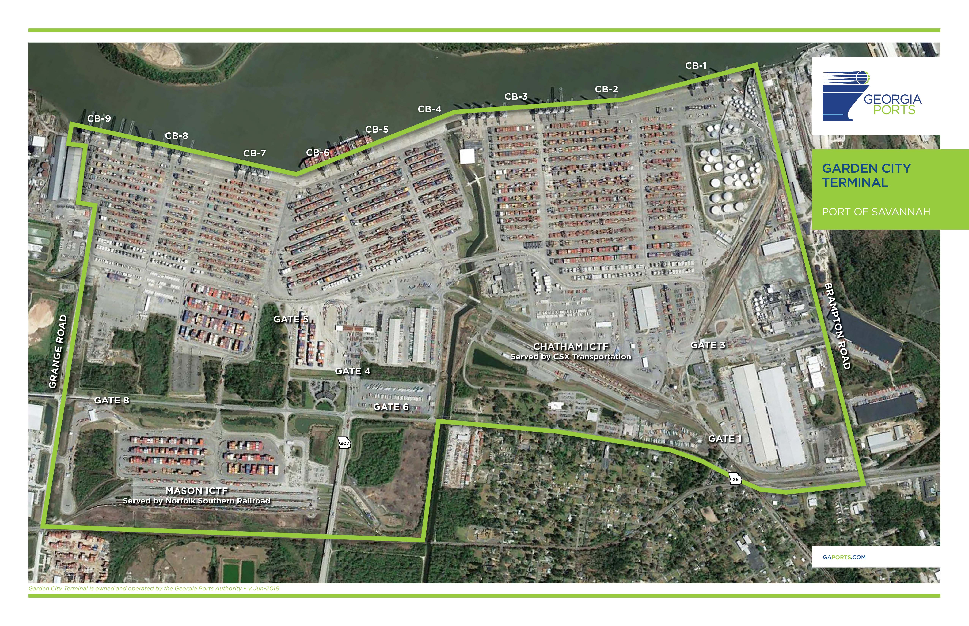
9 Container berths
9,693 ft (2,955 m) of contiguous berthing space
30 Container cranes
146 Rubber-tired gantries
1,200 acres (485.6 ha) terminal area

Slide 5
Savannah:
#4 and Fastest growing
PORT | CY2007 TEUs | CY2017 TEUs
1. LOS ANGELES | 8,355,039 | 9,343,191
2. LONG BEACH | 7,312,465 | 7,544,514
3. NY/NJ | 5,299,104 | 6,710,817
4. SAVANNAH | 2,604,401 | 4,046,216
5. SEA/TAC | 3,031,378 | 2,958,471
6. VIRGINIA | 2,111,264 | 2,841,020
7. HOUSTON | 1,744,668 | 2,459,107
8. OAKLAND | 2,386,363 | 2,420,836
9. CHARLESTON | 1,754,381 | 2,177,557
10. PT. EV | 960,860 | 1,068,335
TOP TEN TOTAL | 35,559,922 | 41,570,064
Source: AAPA; throughput excluding domestic

Slide 6

SAVANNAH: A GLOBAL COMMERCE HUB
37 WEEKLY SERVICES COVERING THE WORLD
THE MOST ON THE U.S. EAST COAST
EVERY MAJOR CARRIER
CALLS SAVANNAH
Key Savannah Service Features:
Offers 10 Services via Panama
Offers 8 Services via Suez
First in = 11; Last out = 10 (All Trades)
35
NY/NJ
8
PHIL
8
BAL
29
NFK
7
WIL
27
CHA
37
SAVANNAH
9
JAX
22
PEV
16
MIA
Source: American Shipper BlueWater Reporting & Carrier Websites July 2018

Slide 7
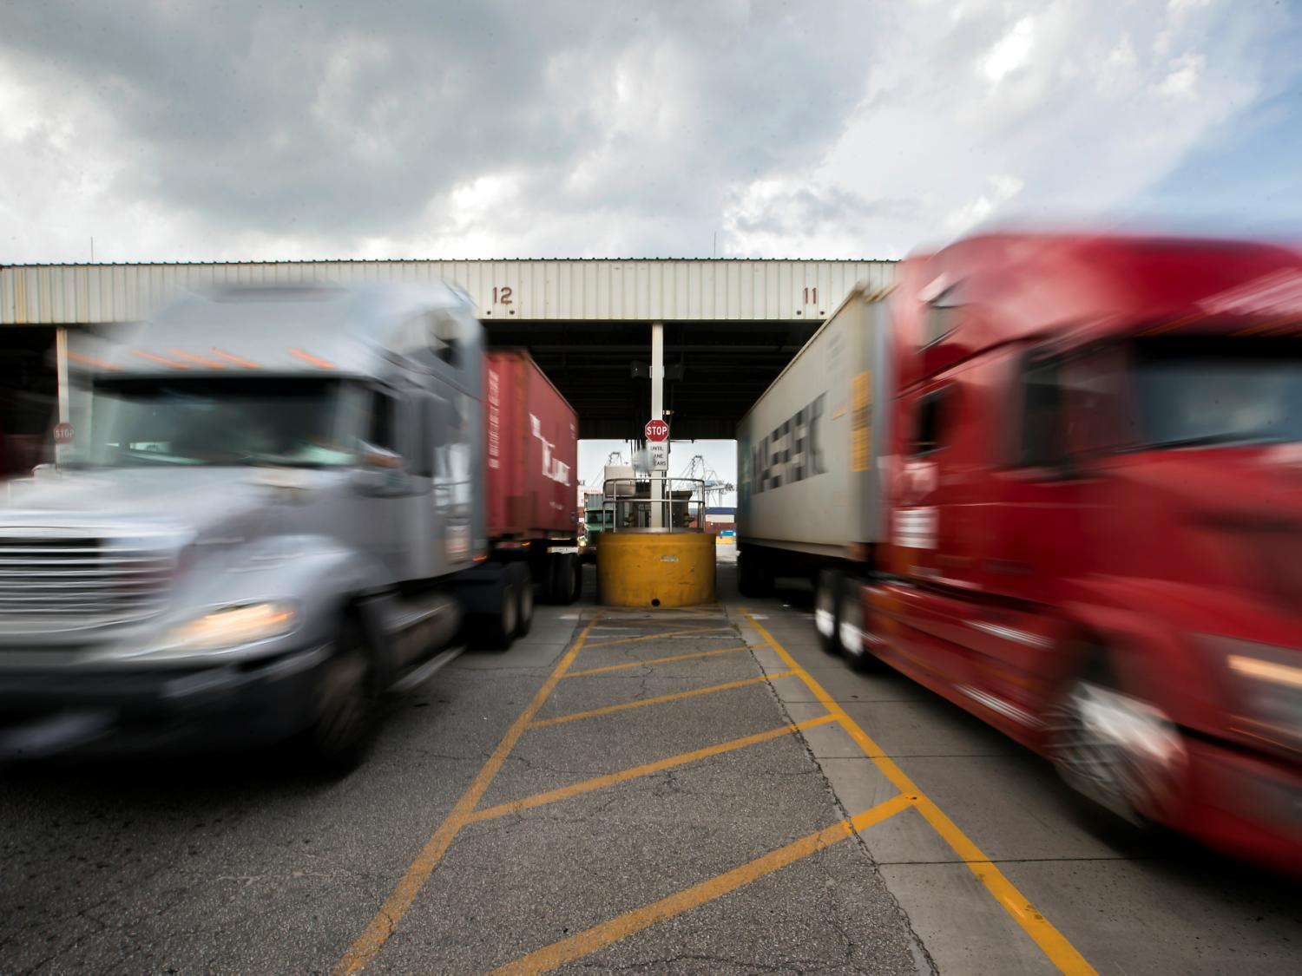
GATE FLUIDITY
AVERAGE OVER 10,200 GATE MOVES/DAY;
SINGLE 33 MINUTES; DOUBLE 53 MINUTES.
4 Gates. 48 Lanes with 28 Pre-check Lanes. 12 Portal Approach Lanes.
Monday through Friday 6am to 6pm
Saturday (Gate 4 only) 8am to Noon, 1pm to 5pm
Source: GPA Gate Operations, Average moves/turn times for July-December 2017 Monday-Friday

Slide 8
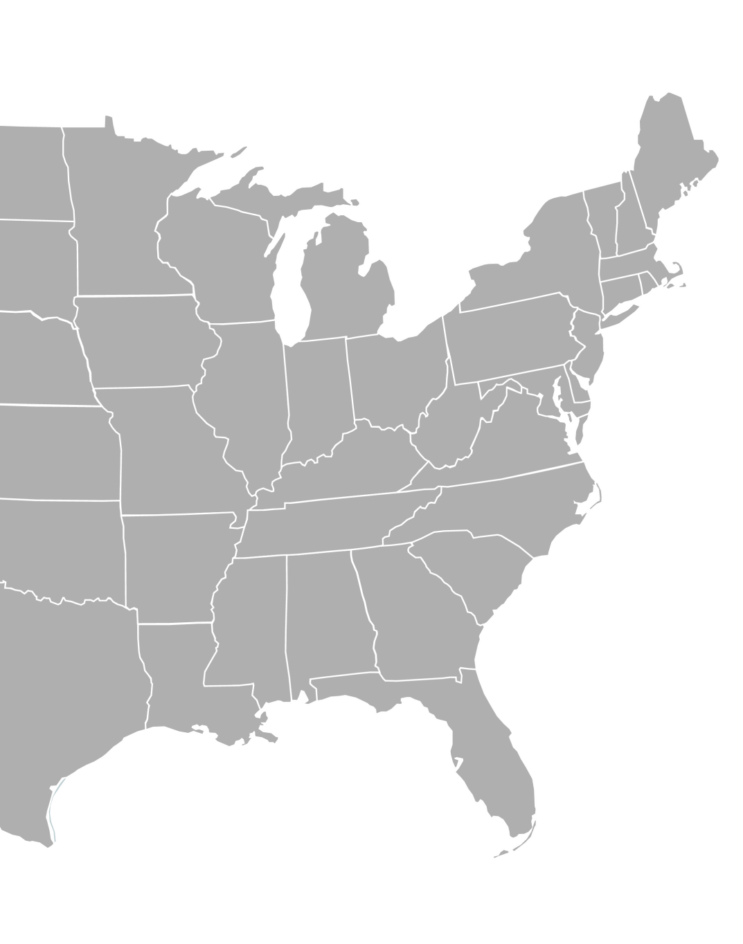








INTERSTATE ACCESS
Georgia has one of the highest over-the-road container weight allowances among all U.S. Southeast states.
Garden City Terminal to I-16 (East/West)
6.0 miles (9.7 km)
Garden City Terminal to I-95 (North/South)
5.8 miles (9.3 km)
Milwaukee
Detroit
Cleveland
Chicago
Columbus
Louisville
Kansas City
St. Louis
Nashville
Charlotte
Chattanooga
Columbia
Memphis
Birmingham
Atlanta
Dallas
Savannah
Orlando

Slide 9
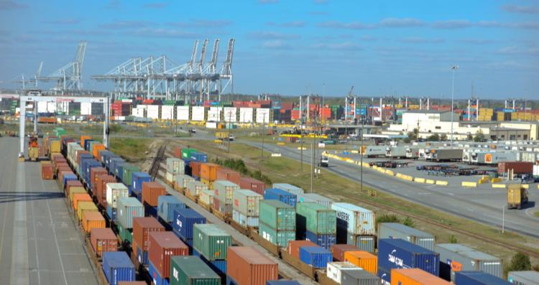
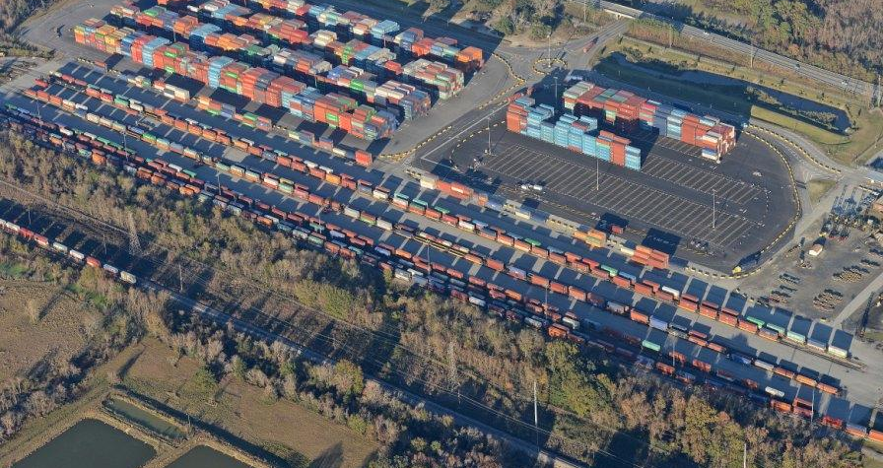
FREIGHT MOBILITY
Continued investment in rail infrastructure expansion to support greater inland access for our customers.
THE CHATHAM ICTF
THE MASON ICTF
Served by CSX Transportation
RTGs
Working Tracks: (3) 2,100 ft (640 m)
Total = 6,300 ft (1,920 m)
Storage Tracks: 11,615 ft (3,540 m)
Served by Norfolk Southern Railroad
Toplifts
Working Tracks: (5) 2,800 ft (853 m)
Total = 14,000 ft (4,267 m)
Storage Tracks: 8,000 ft (2,438 m)

Slide 10
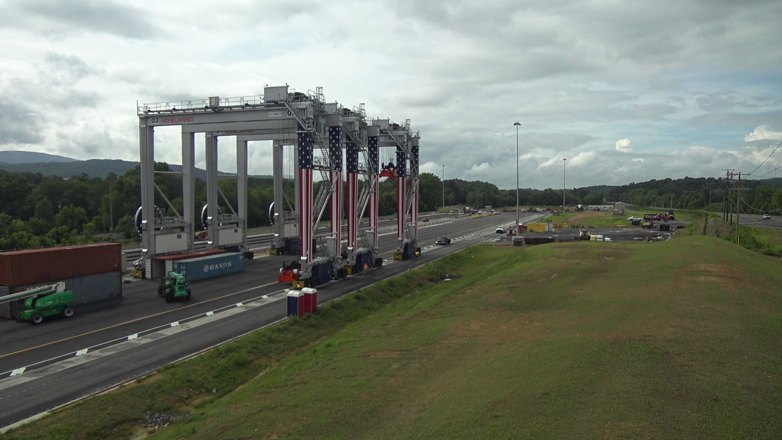

APPALACHIAN REGIONAL PORT
A GPA Intermodal Site in Murray County, Georgia Served by CSX
Grand Opening August 2018
Alleviating congestion in Atlanta & stimulating economic development

Slide 11
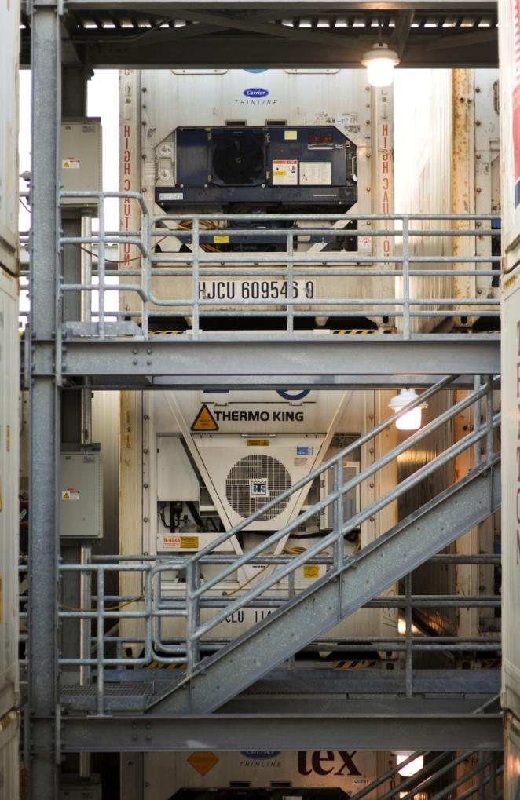
REFRIGERATED CARGO CAPACITY
104 refrigerated container racks, each servicing 24 containers
390 powered wheeled locations
Total current capacity: 2,886 units
23 additional reefer racks to become operational in March 2019, adding 552 units of capacity

Slide 12
PORT OF SAVANNAH: gateway
For AGRICULTURAL trade
In CY2017, nearly 1 million TEUs of containerized agricultural products moved via the Port of Savannah, the second most along the U.S. East Coast and the most in the South Atlantic.
The Port of Savannah was the leading U.S. South Atlantic port for its top ten containerized agricultural commodities.
Over four times more agricultural products were exported via the Port of Savannah than imported.
Container Trade via the Port of Savannah during CY2017
Top Agricultural Products | TEUs
Paper & Paperboard including Waste | 187,776
Wood Pulp | 181,615
Logs & Lumber | 116,273
Clay | 98,432
Raw Cotton/Fabric | 97,859
Wood & Wood Products | 75,110
Poultry | 68,871
Pet & Animal Feeds | 26,482
Edible Nuts | 17,127
Field Seeds & Bulbs | 16,337
Source: PIERS (Loaded Cargo); Based on PIERS’ COM4 Commodity Codes

Slide 13
CONTAINERIZED AGRICULTURAL trade VIA THE PORT OF SAVANNAH is GROWING
Containerized Agricultural Trade via the Port of Savannah
CY2013-CY2017
Grew 13% between CY2013 and CY2017
Source: PIERS (Loaded Cargo); Based on PIERS’ COM4 Commodity Codes

Slide 14
SAVANNAH: #1 U.S. EAST COAST PORT FOR AGRICULTURAL exports
Containerized Agricultural Exports via U.S. East Coast Ports during CY2017
Source: PIERS (Loaded Cargo); Based on PIERS’ COM4 Commodity Codes

Slide 15
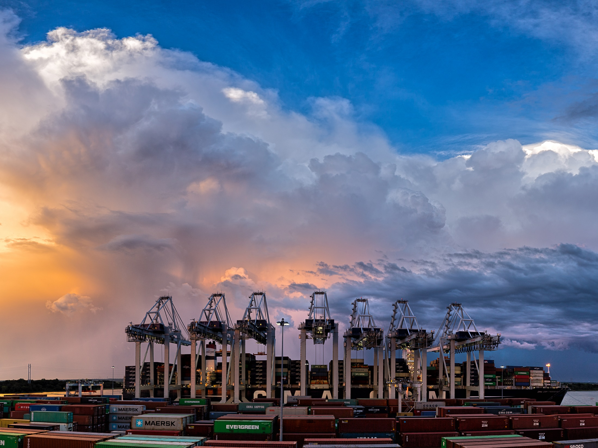
THANK YOU

